Slide 1
Optical Flow
Slide courtesy: Derek Hoiem, Kristen Grauman

Slide 2
Motion is a powerful perceptual cue
Even “impoverished” motion data can evoke a strong percept
G. Johansson, “Visual Perception of Biological Motion and a Model For Its Analysis", Perception and Psychophysics 14, 201-211, 1973.

Slide 3
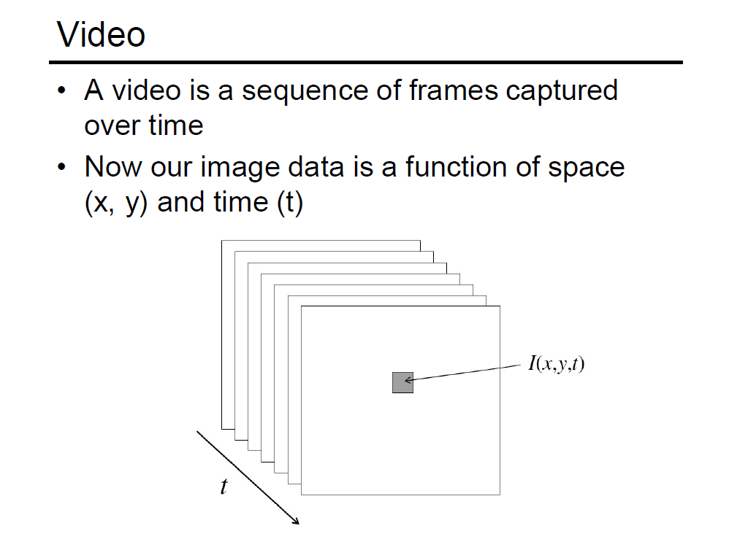

Slide 4
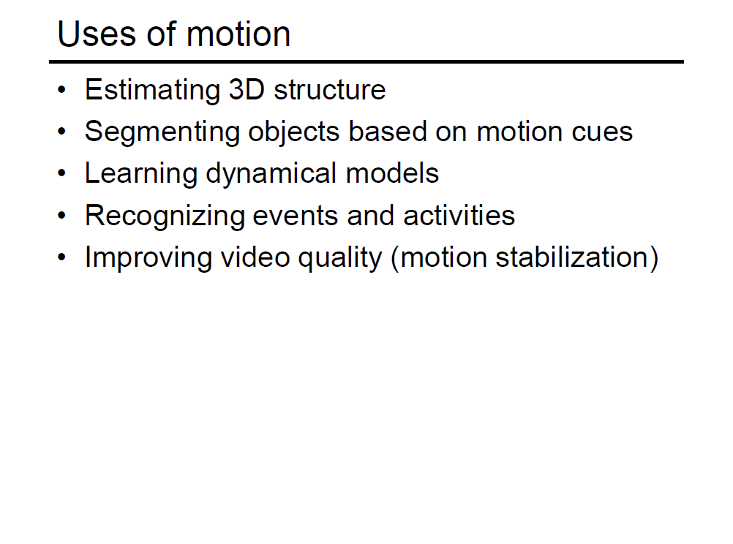

Slide 5
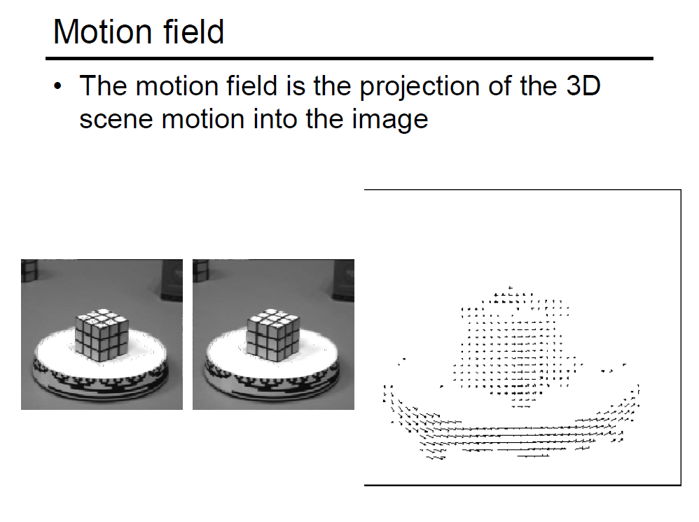

Slide 6
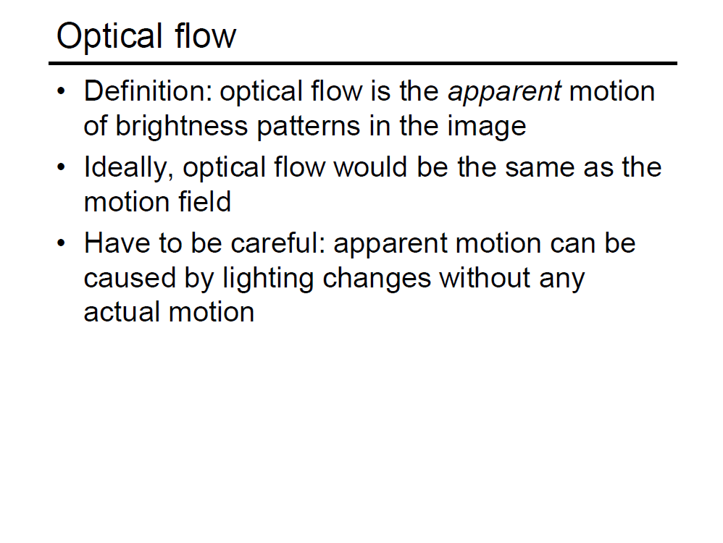

Slide 7
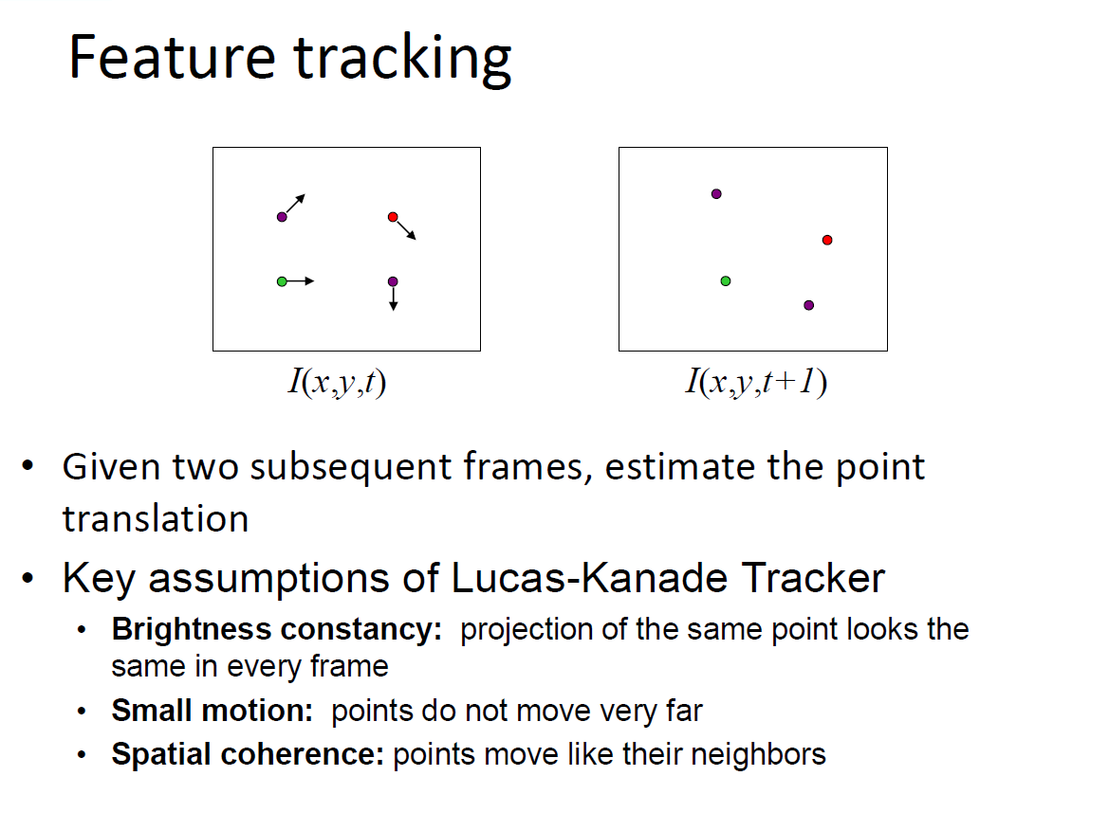

Slide 8
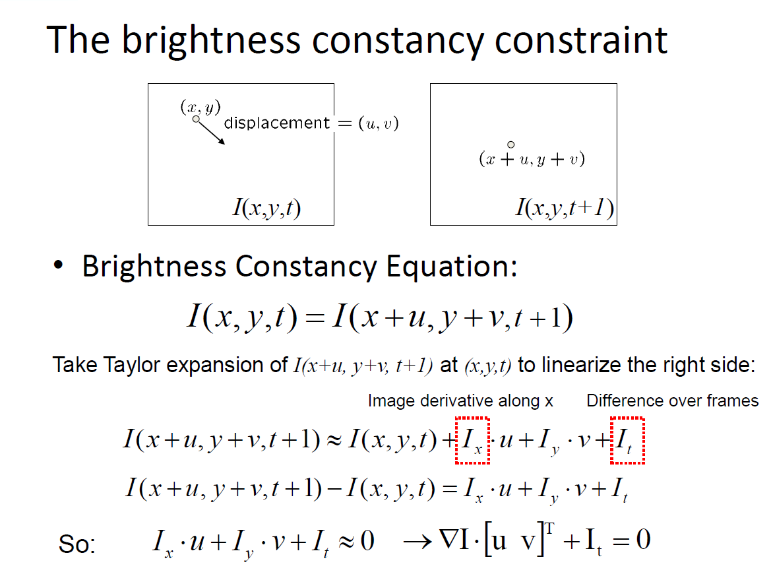

Slide 9
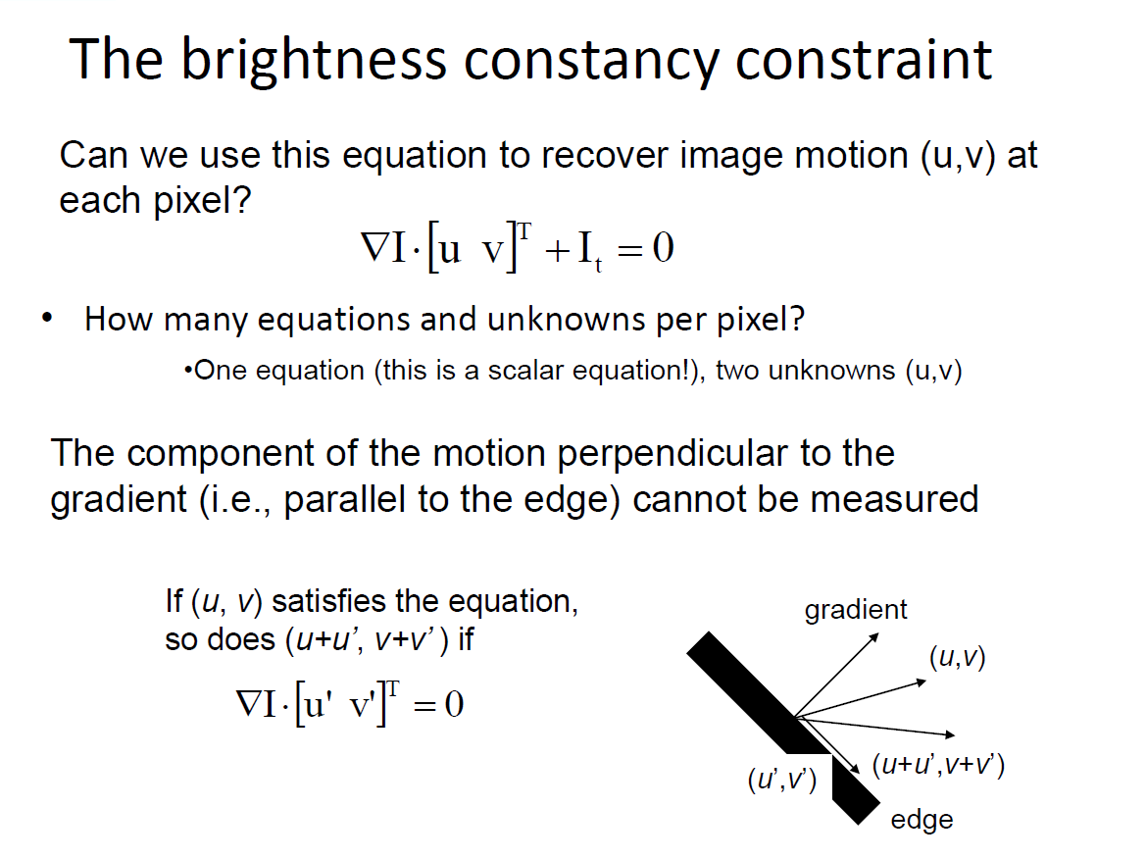

Slide 10
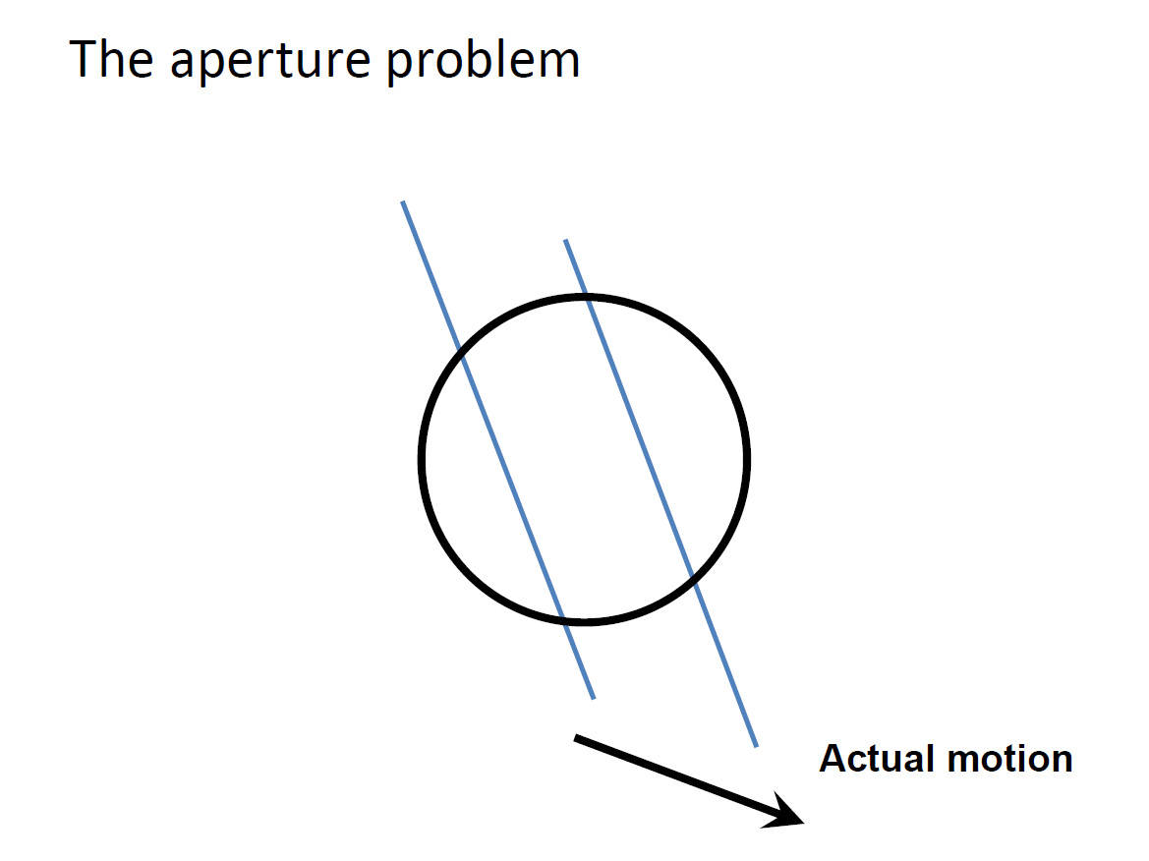

Slide 11
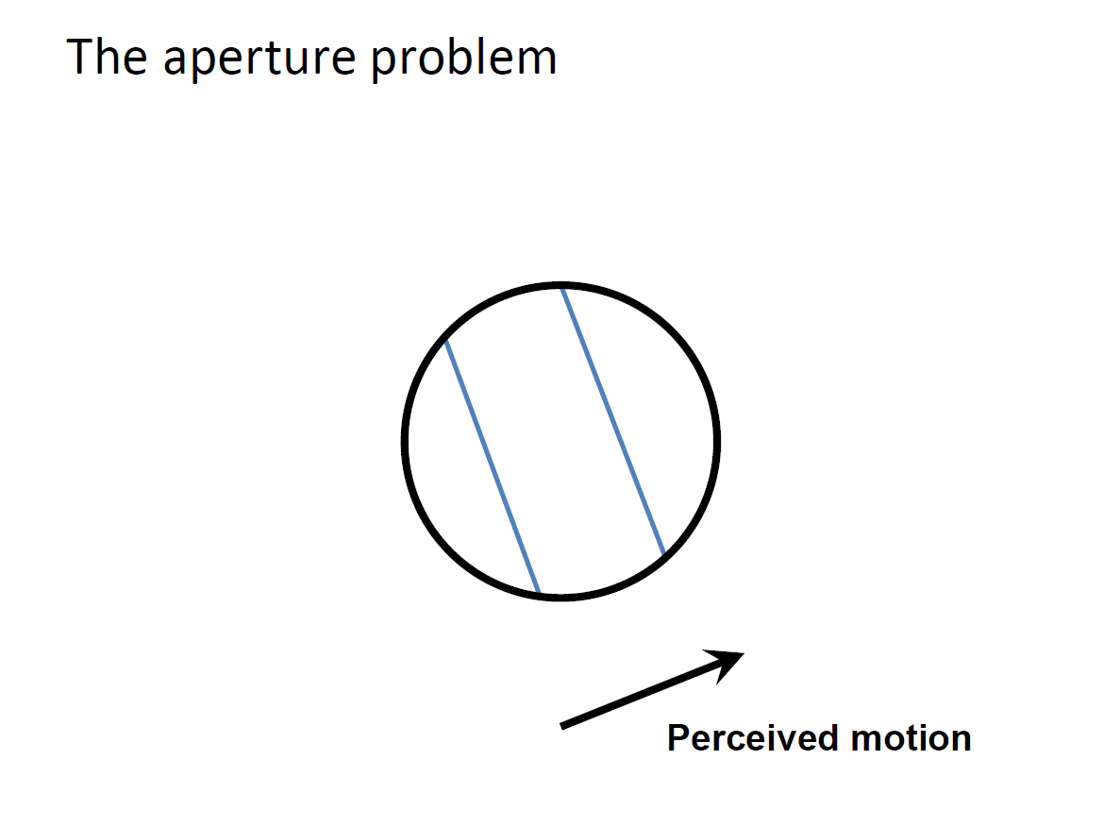

Slide 12
The barber pole illusion
http://en.wikipedia.org/wiki/Barberpole_illusion

Slide 13
The barber pole illusion
http://en.wikipedia.org/wiki/Barberpole_illusion

Slide 14
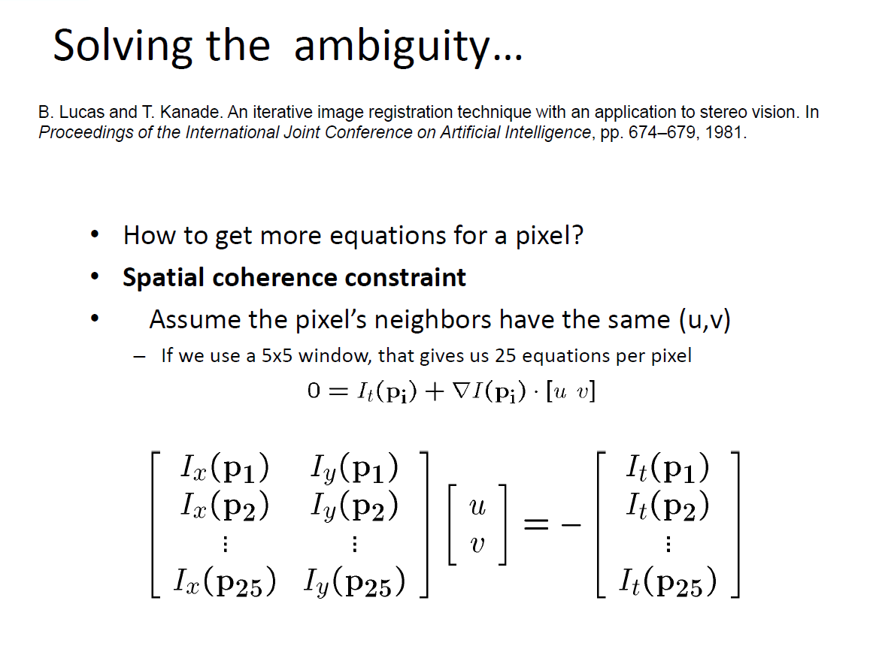

Slide 15
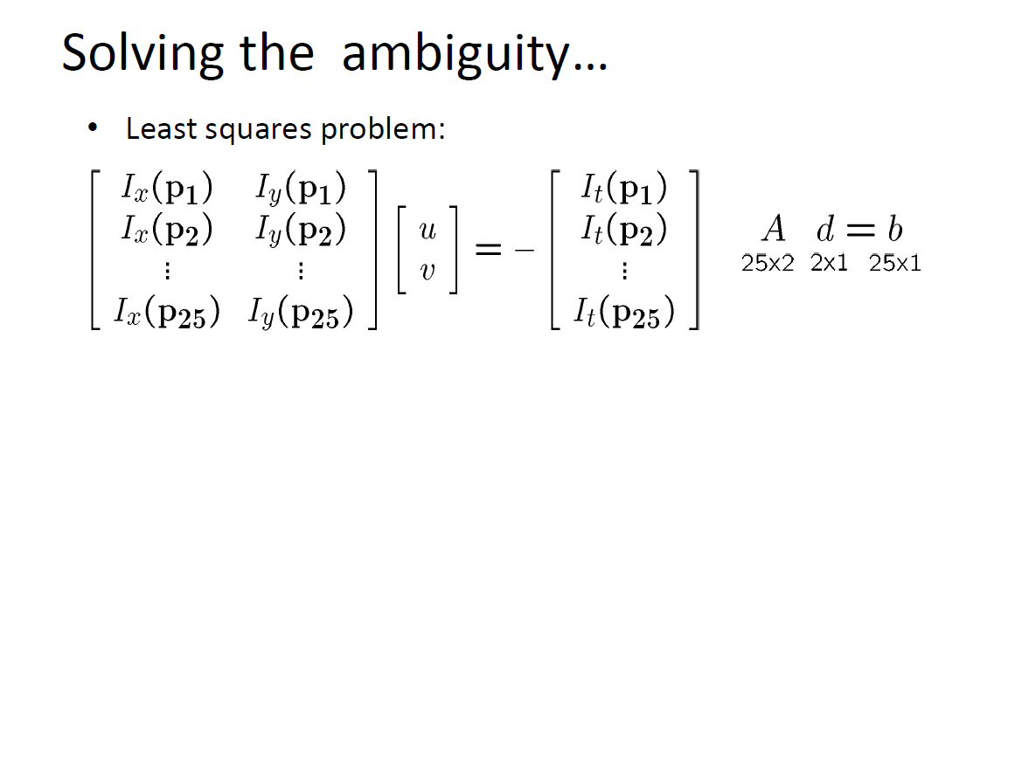

Slide 16
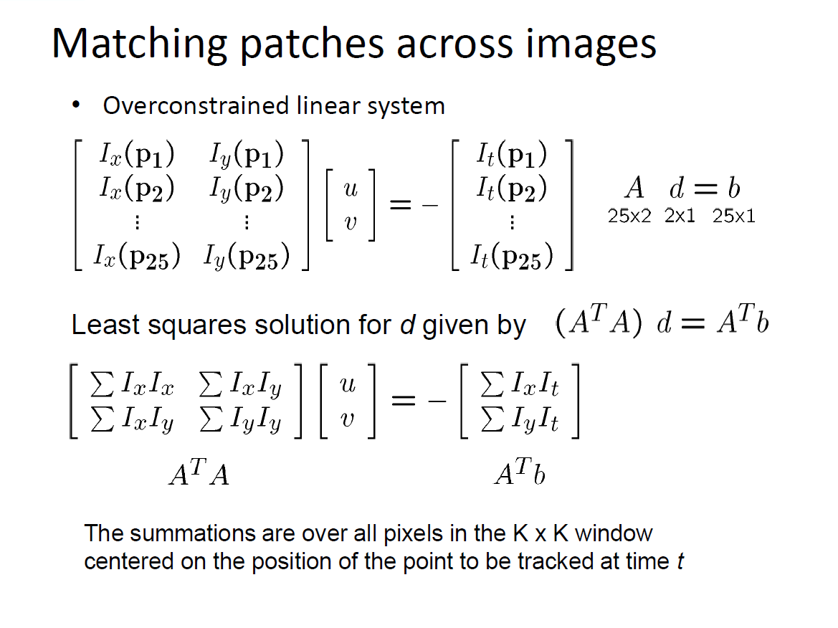

Slide 17
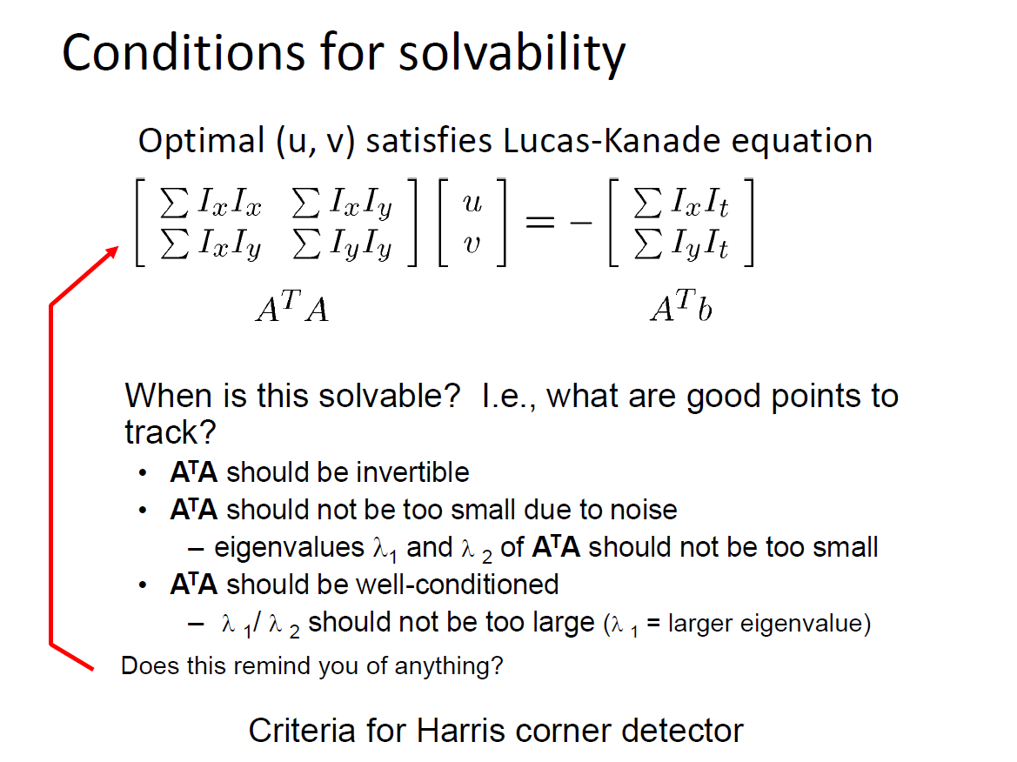

Slide 18
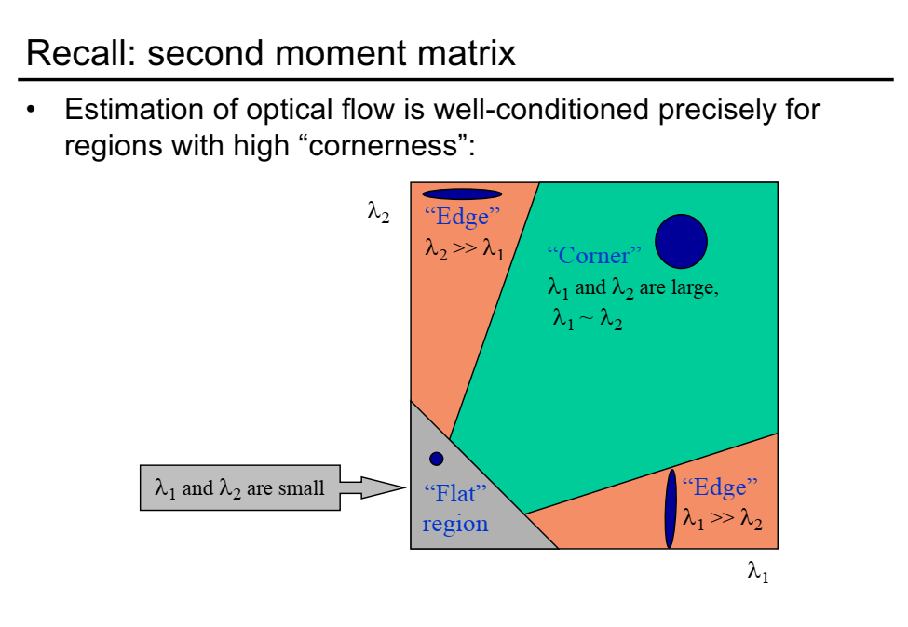

Slide 19
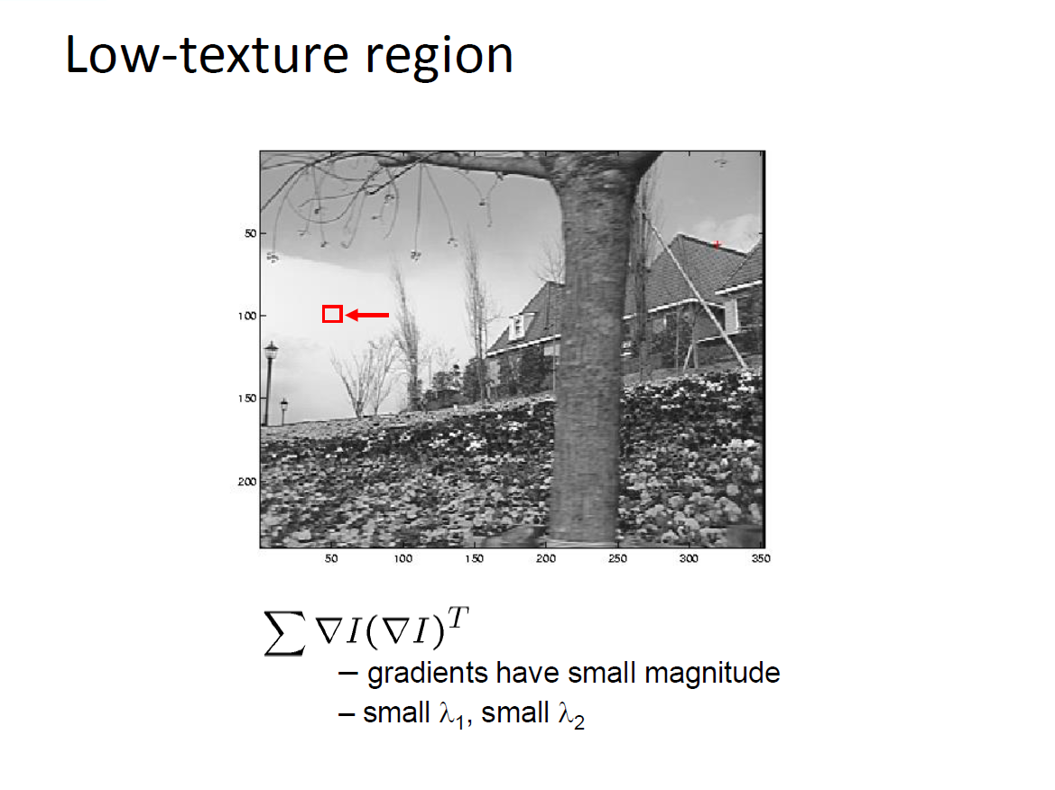

Slide 20
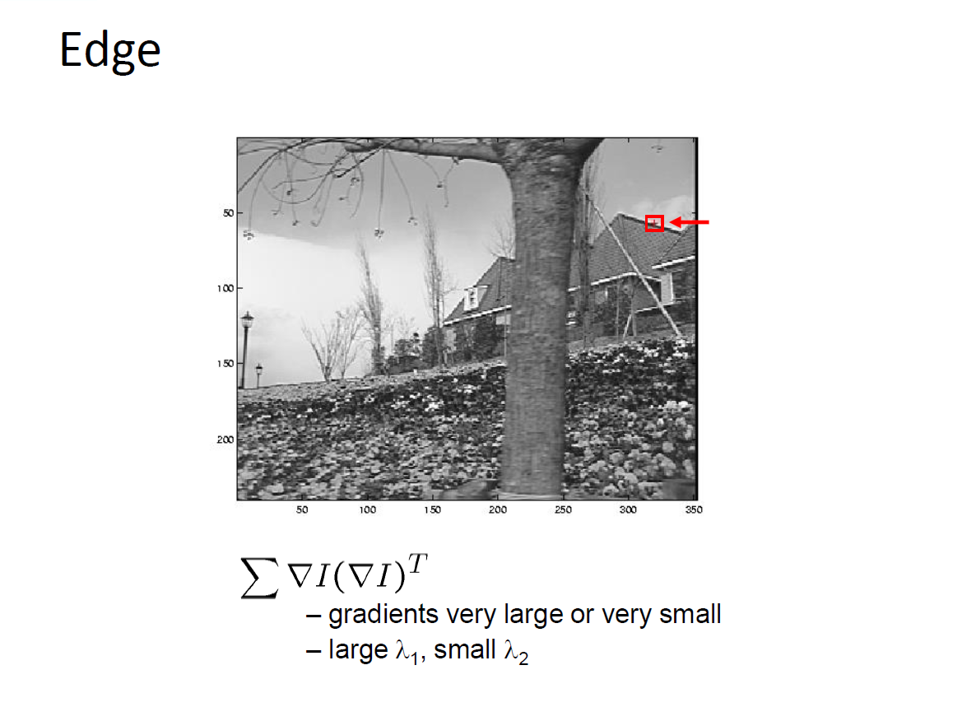

Slide 21
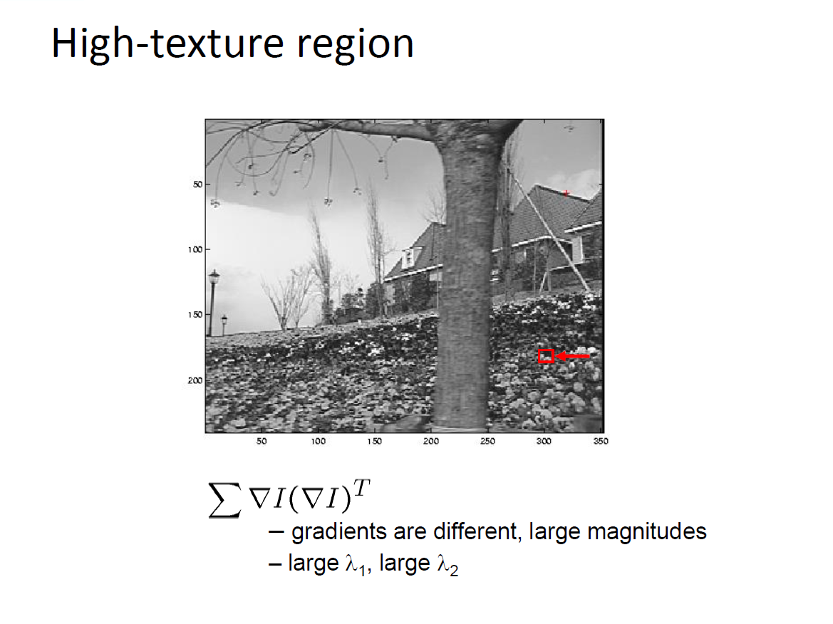

Slide 22
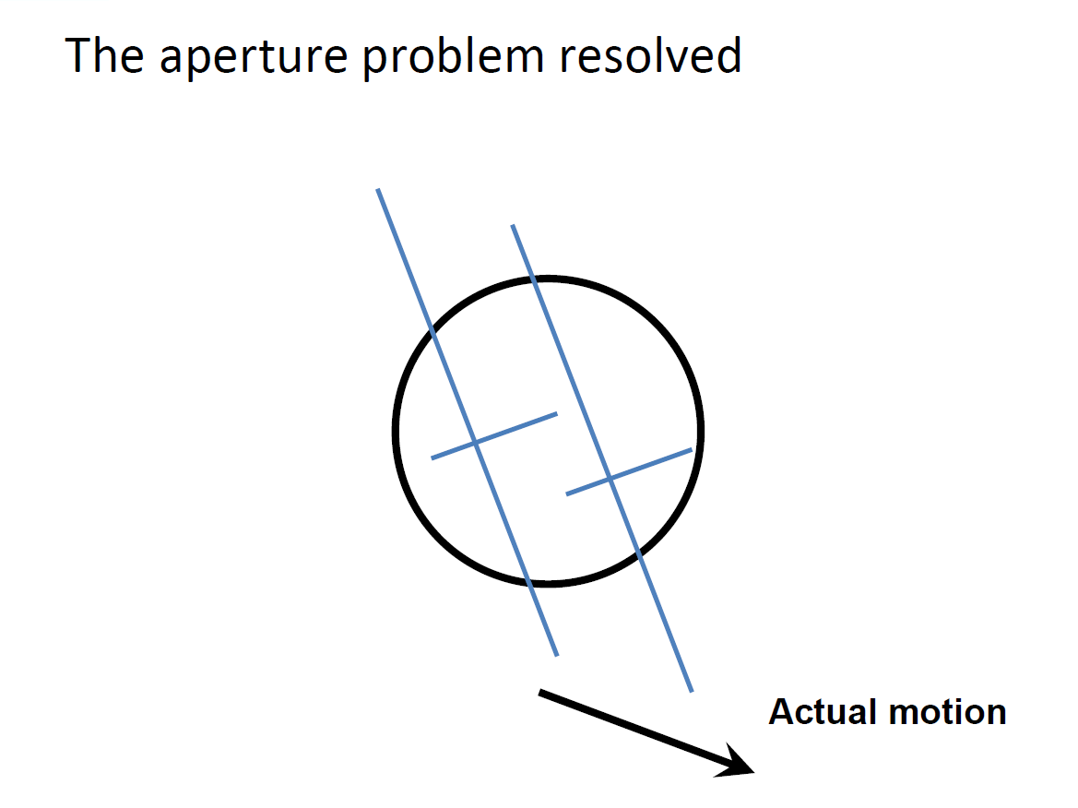

Slide 23
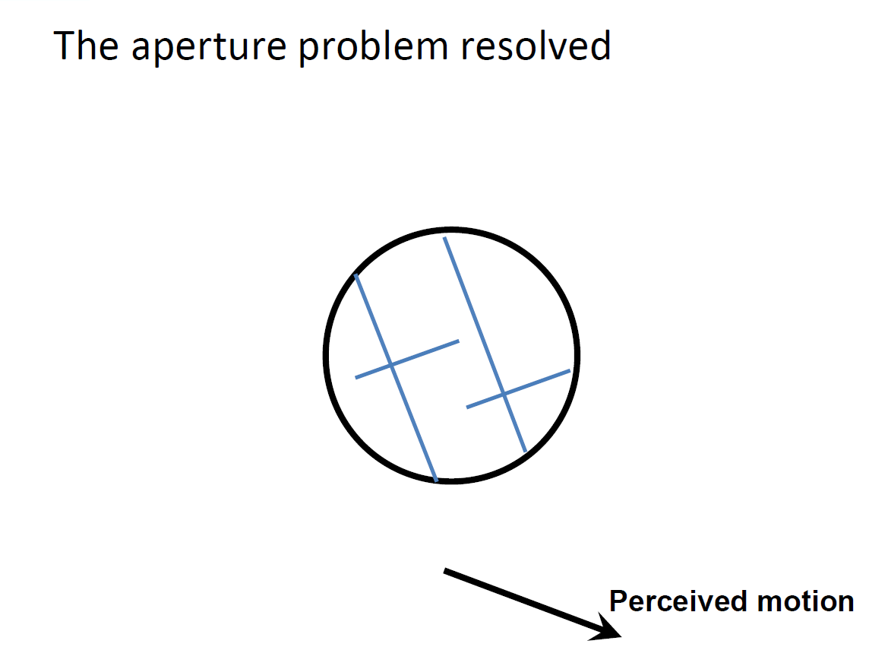

Slide 24
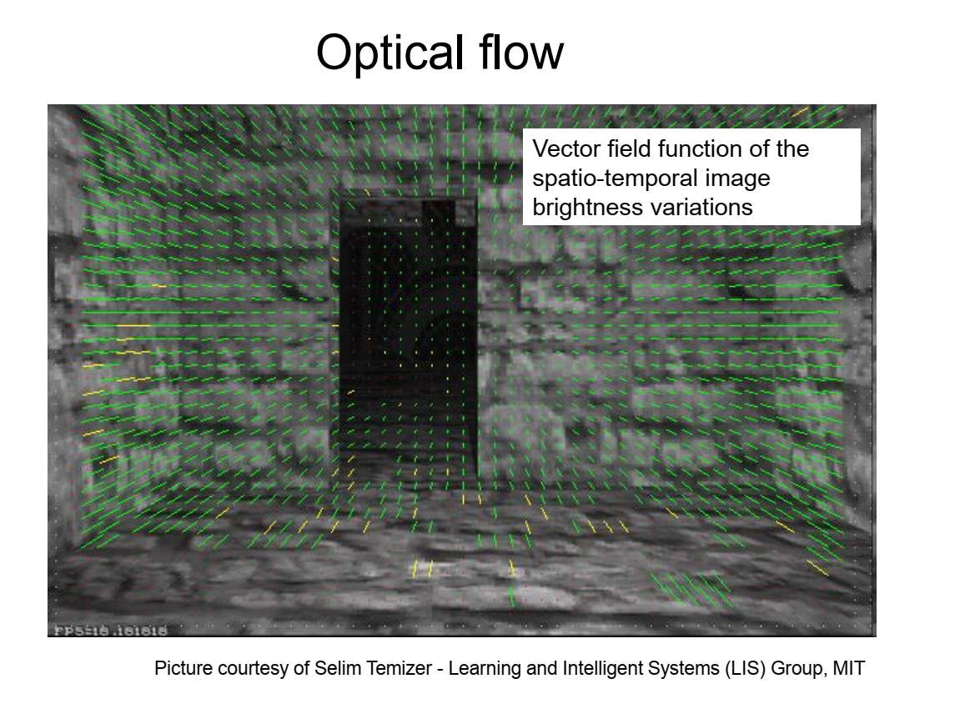

Slide 25
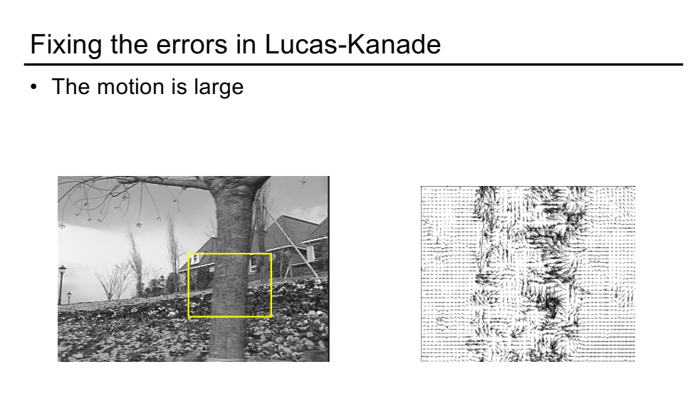

Slide 26
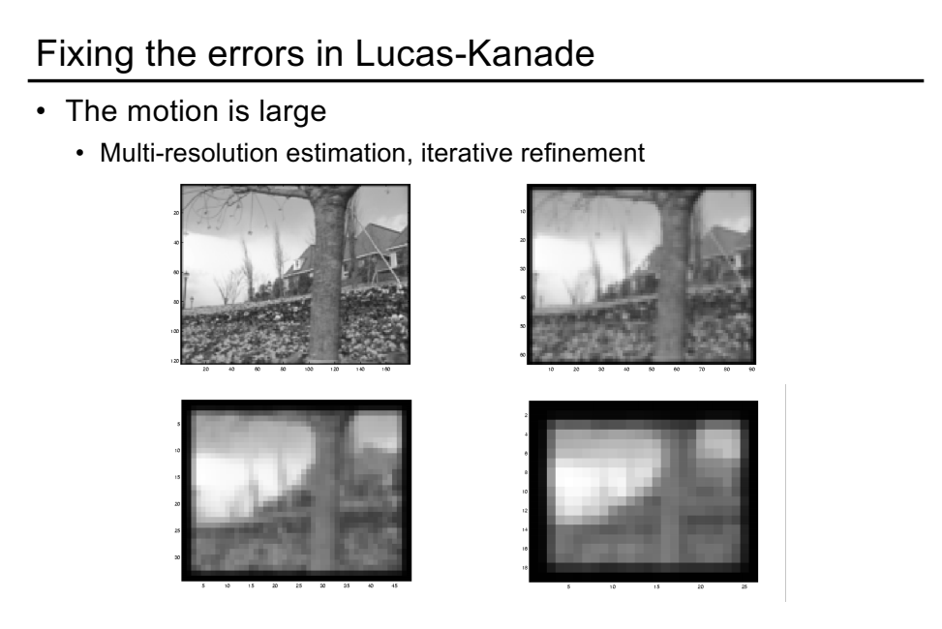

Slide 27
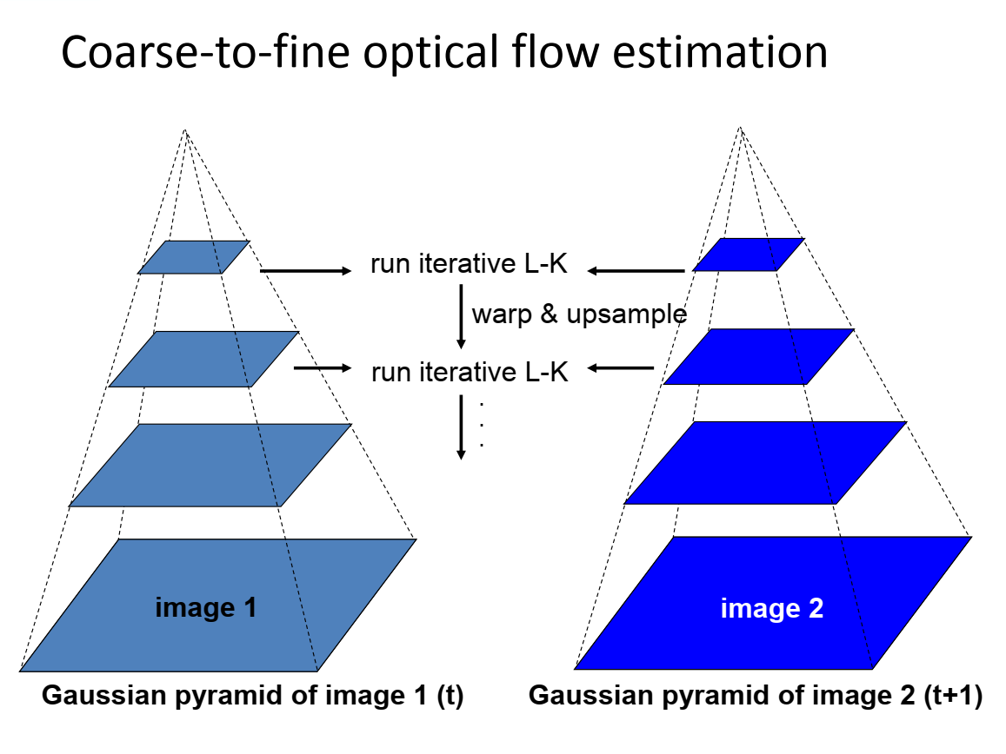

Slide 28
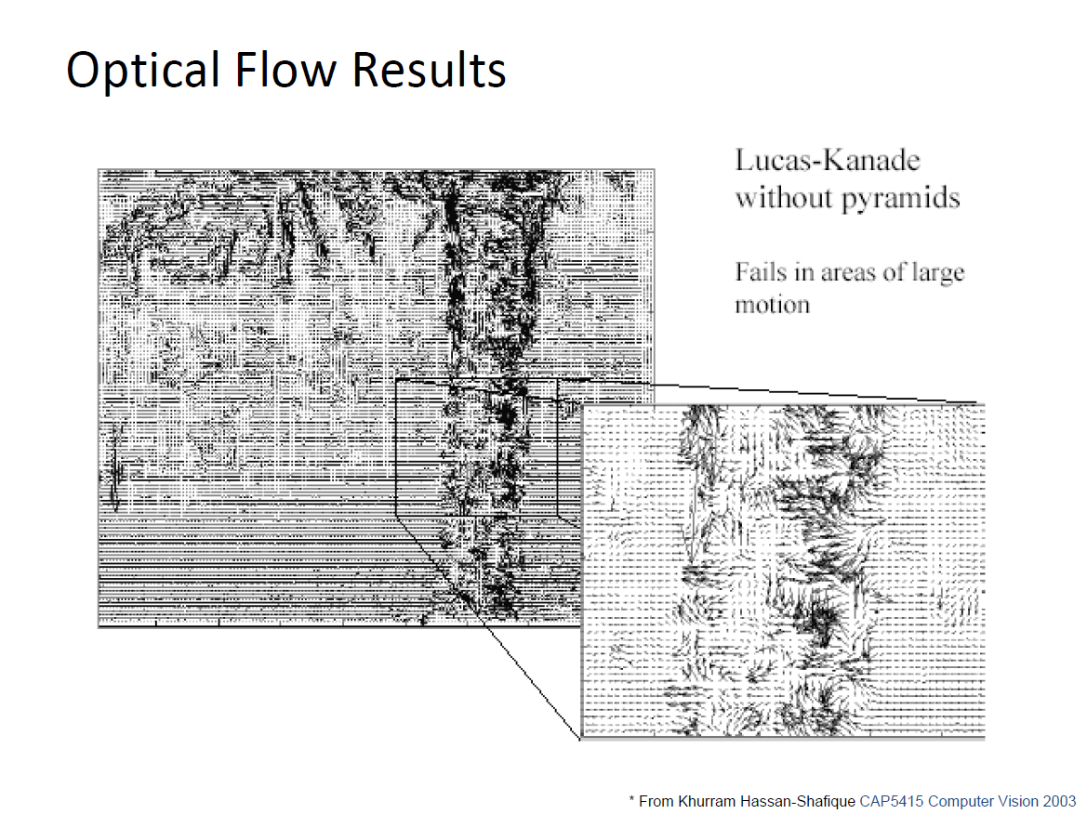

Slide 29
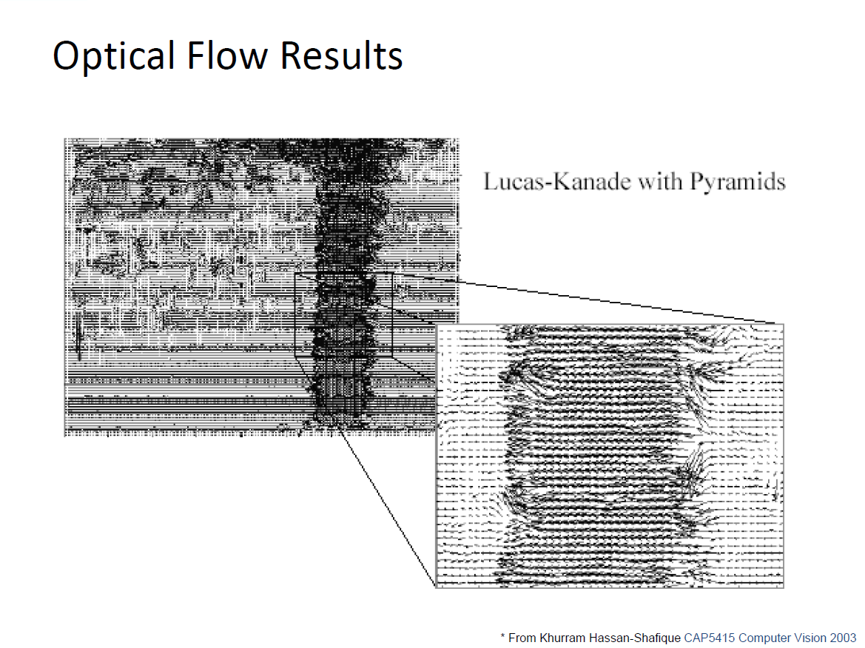

Slide 30
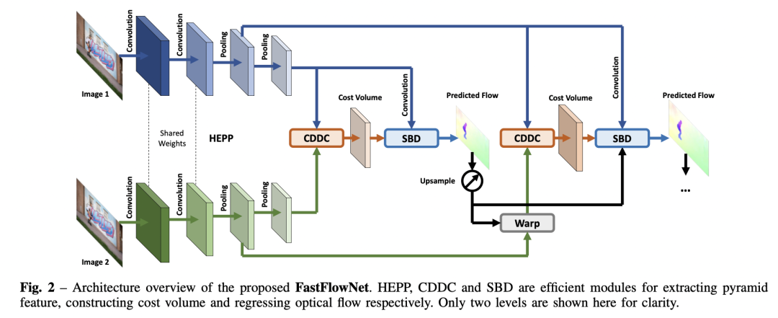
State-of-the-art optical flow estimation
Kong et.al. FastFlowNet: A Lightweight Network for Fast Optical Flow Estimation. ICRA 2021

Slide 31
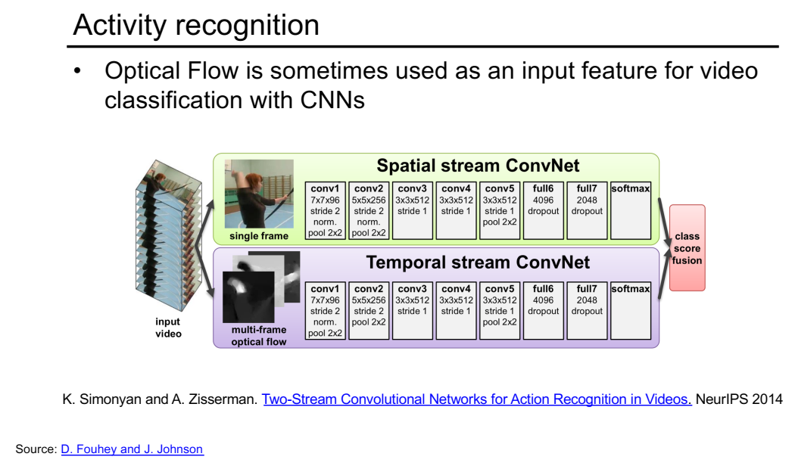

Slide 32
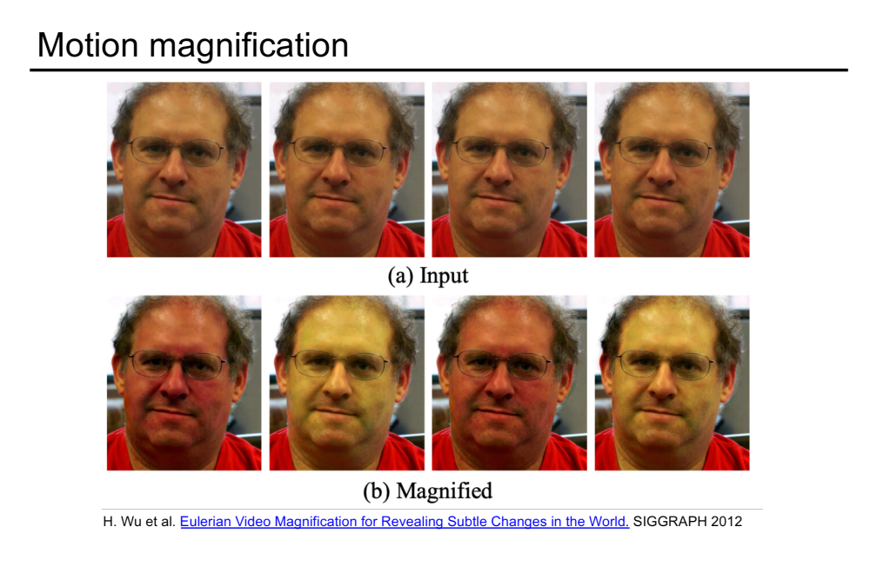

Slide 33
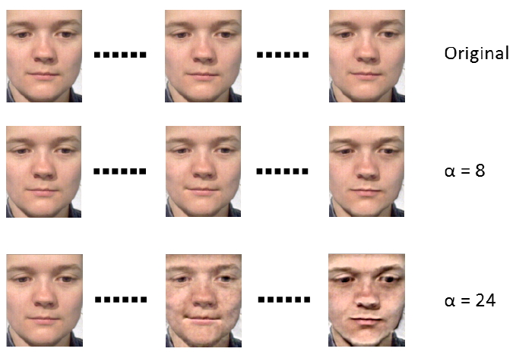
微表情识别
原始视频
放大20倍

